Slide 1

MY INTERNSHIP
LYVA VAN DAMME

Slide 2
AGENDA SLIDE
I
INTRODUCTION
II
TIMELINE
III
THE IDEA
IV
DEMO
V
REFLECTION

Slide 3

INTRODUCTION

Slide 4
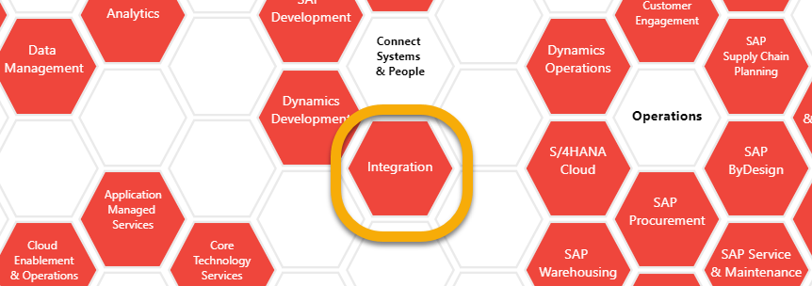
Introduction About …
Integration is a part of “Connect Systems & People”. We connect systems and people.
SAP INTEGRATION
The bridge that controls and connects all traffic.
STUDENT INFORMATICS
Flexibility and ability to adapt quickly to change, are one of the most important competences.

Slide 5

TIMELINE

Slide 6
INTERNSHIP TIMELINE
W 1 - 4
W 4 - 6
W 6 - 10
W 10 - 14
TRAC-excercises
Research about Enterprise Messaging
Research about Enterprise Messaging
Creating flows in CPI
Testing
Research about webhooks
Optimize the flows
Testing
Testing
Create GUI
Optimize the flows and the GUI
Extensions

Slide 7

THE IDEA

Slide 8

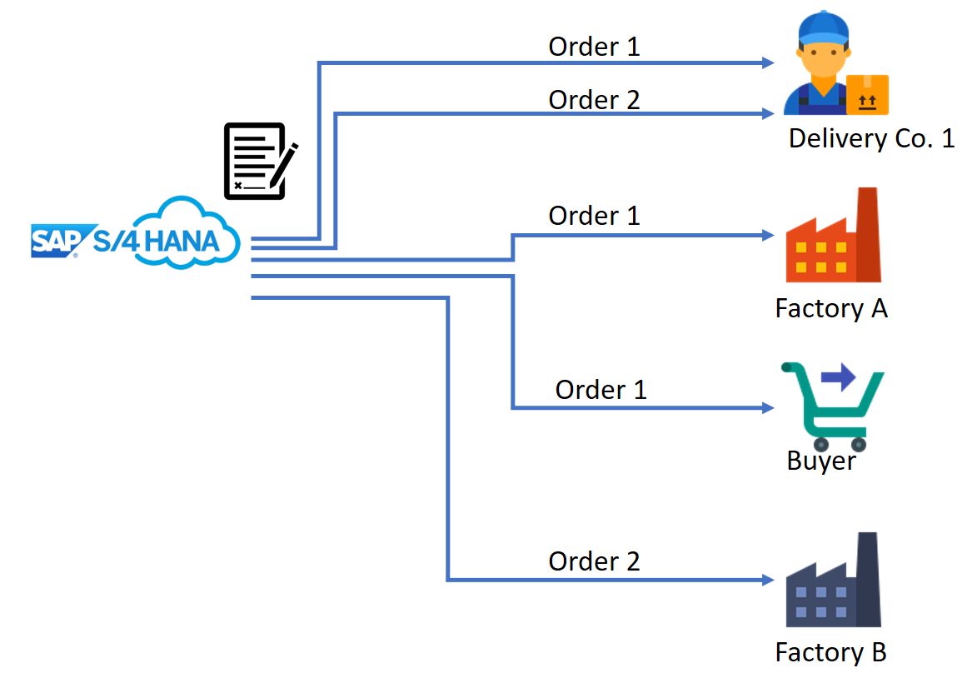
THE IDEA BUSINESS CASE
SOLUTION TO GET NOTIFIED WHEN A CHANGE HAPPENS
A ROCK-SOLID ENVIRONMENT WITH ALL THE OPPORTUNITIES YOU NEED TO TAKE CAREER FORWARD
A ROCK-SOLID ENVIRONMENT WITH ALL THE OPPORTUNITIES YOU NEED TO TAKE CAREER FORWARD
A SOLUTION TO BUILD AN ARCHITECTURE THAT IS DYNAMIC, ROBUST AND REUSABLE

Slide 9

THE IDEA REQUIREMENTS
Dynamic solution
Enterprise Messaging
No manual interaction
Graphic user interface

Slide 10

THE IDEA ENTERPRISE MESSAGING
a cloud-based messaging service for the development of decoupled and resilient applications, services, and systems.
ENTERPRISE
A "program-to-program" messaging between applications and systems throughout an enterprise.
MESSAGING
A messaging system allowing software applications and systems to communicate semantically.

Slide 11







THE IDEA USED PROGRAMS
API Management
SAP Enterprise Messaging
Cloud Integration
Connectivity
OData Provisioning
Open Connectors

Slide 12

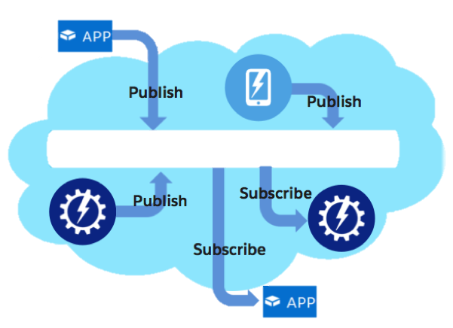
THE IDEA EXAMPLE

Slide 13

THE ARCHITECTURE CLOSE-UP
Register company
Subscribe on salesorder
Getting mails when changes happen
Change on a salesorder
Pushing messages on one queue
Logic distribution of the messages
Notify listeners

Slide 14

THE IDEA ARCHITECTURE
Exists multiple times in the architecture
Distribution logic
Topic:
ordernumber
Mail
Topic:
S4/BO/SalesOrder/*
Consumption and acknowledgement
Queue:
EM_Demo
Company name as queue name

Slide 15

THE IDEA ADVANTAGES
Connect applications, services, systems
Communicate reliably at scale
Event-driven extensions for SAP S/4HANA
High throughput of messages low latency

Slide 16

INTERFACE
Two screens Register company Subscribe on order
EVERY 10 MINUTES
Consumption Acknowledgement
CHANGE HAPPENS
Clients receive mails

Slide 17

DEMO

Slide 18

REFLECTION

Slide 19
FINAL THOUGHTS MY INTERNSHIP
THE INTERNSHIP TASK
Challeging
Varying
WHAT I LEARNED
Be open
Ask questions
Do research
MY WORK POINTS
Be independent
Don’t be so stubbron
Ask multiple people for help

Slide 20

QUESTIONS?

